Slide 1
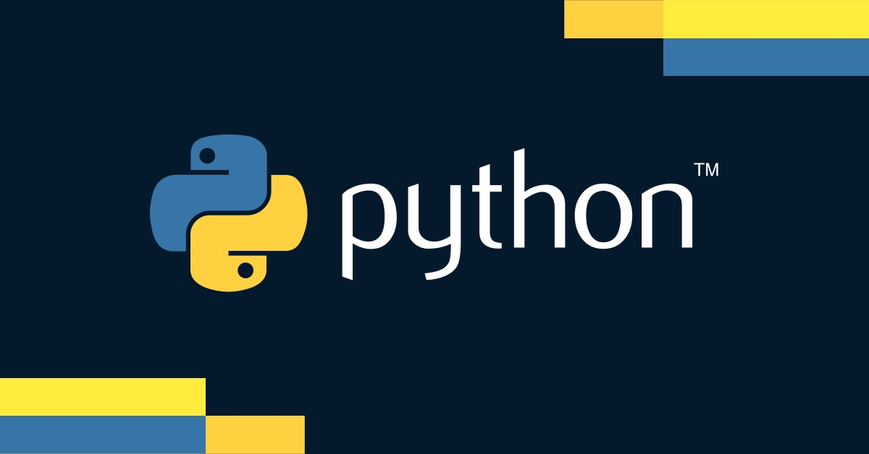

Slide 2

Data Analysis and Visualization
With Matplotlib

Slide 3
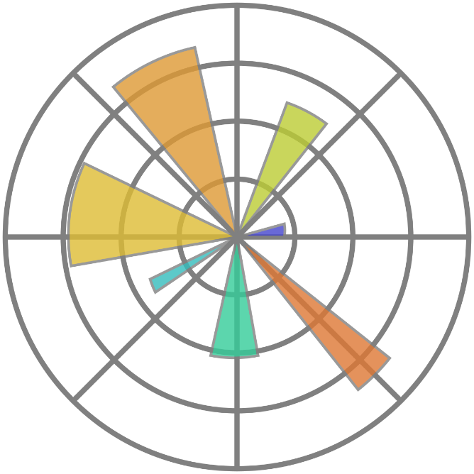
Introduction to Matplotlib
What is Matplotlib?
Python library used for creating static, animated, and interactive visualizations
Importance of Visualization in Data Analysis
Helps in understanding data patterns, trends, and relationships
Make complex data more accessible and interpretable

Slide 4
Installing Matplotlib
Installation Steps
Use pip to install Matplotlib: pip install matplotlib
Setting up Matplotlib
Helps in understanding data patterns, trends, and relationships
Make complex data more accessible and interpretable

Slide 5
Basic Plotting with Matplotlib
Line Plots
plt.plot(x, y)
Plotting continuous data points connected by straight lines
Scatter Plots
plt.scatter(x, y)
Displaying data points as markers for visualizing relationships between two variables
Bar Plots
plt.bar(x, height)
Representing categorical data using bars of varying heights

Slide 6
Customizing Plots in Matplotlib
Adding Titles and Labels
plt.title()
plt.xlabel()
plt.ylabel()
Providing informative titles and axis labels to enhance plot interpretation
Changing Colors and Styles
color=, linestyle=, marker=
Displaying data points as markers for visualizing relationships between two variables
Adjusting Axes and Ticks
plt.bar(x, height)
Setting axis limits and modifying tick marks for better data visualization

Slide 7
Best Practices for Effective Data Visualization
Choosing the Right Plot Type
Selecting appropriate plot types based on data characteristics
Changing Colors and Styles
Designing plots with clear labels, appropriate colors, and consistent styles for easy interpretation
Adjusting Axes and Ticks
Creating visualizations that convey insights effectively to a non-technical audience or stakeholders

Slide 8
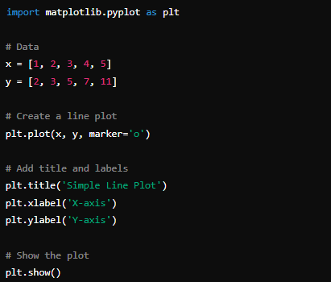
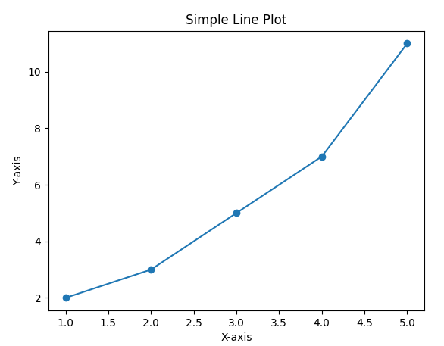
Line Plot

Slide 9
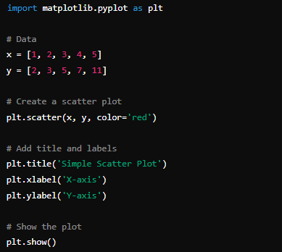
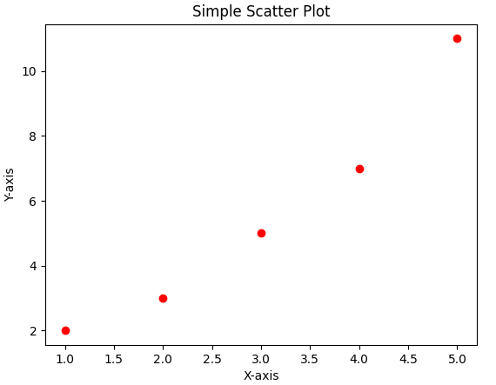
Scatter Plot

Slide 10
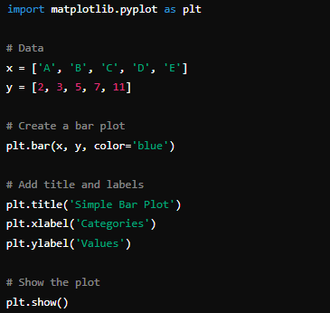
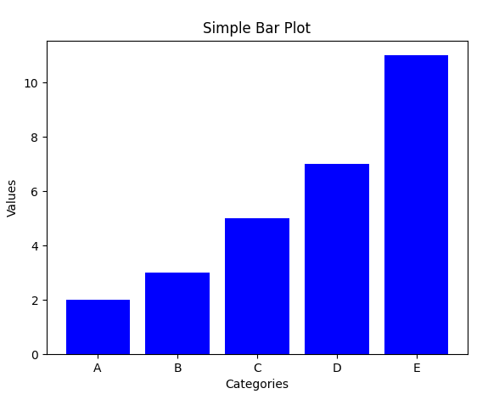
Bar Plot

Slide 11

What is the primary use of Matplotlib in Python?
Data Visualization
Which command is used to install Matplotlib using pip?
pip install matplotlib
What function is used to create a line plot in Matplotlib?
A Pandas moduleplt.plot()
Which Matplotlib function would you use to create a bar chart?
plt.bar()

Slide 12

Practice lectures steps

